Slide 1

Red Hat JBoss Fuse 6.0
Websocket HTML 5 demo

Slide 2
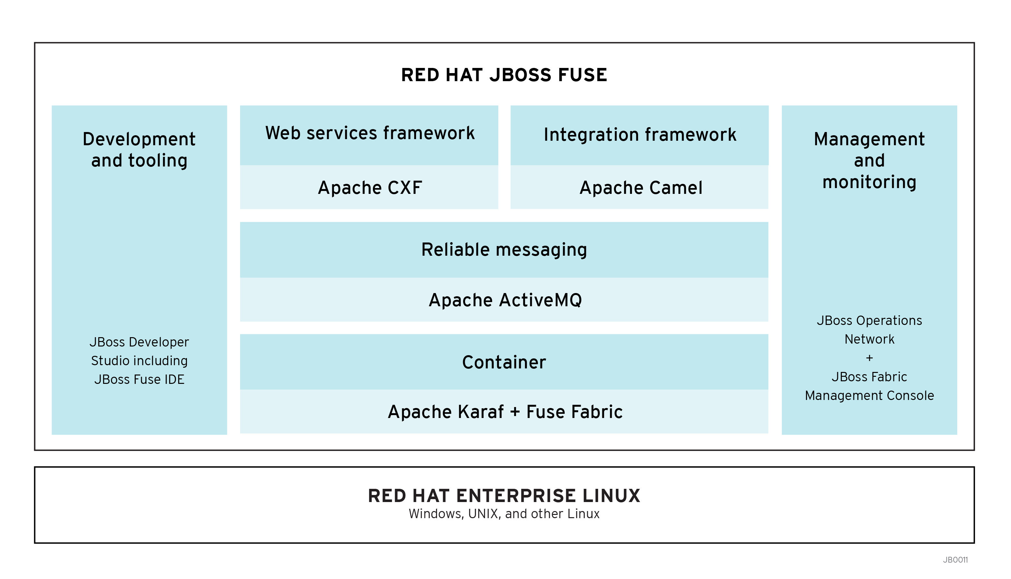
Demo architecture
1. HTTP Request (Upgrade)
2. HTTP Response
3. Stomp Subscribe
4. Message received
from Topic
5. Send WebSocket Data
Notes:
JBoss A-MQ, is a small-footprint, high-performance, open source messaging platform
Supports real-time integration everywhere
The lack of license fees combined with high-performance, reliable messaging that can be used with any development environment provides a solution that supports integration everywhere.

